Slide 1
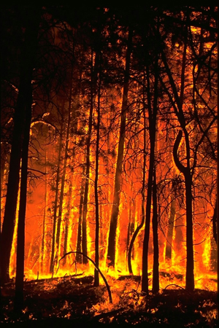
Wildland Fire Science at USGS
To develop the best wildland fire science, and deliver information about fire-landscape-climate interactions to address national fire management priorities and policy requirements.
Valley Complex
Bitterroot Valley
August 2000

Slide 2
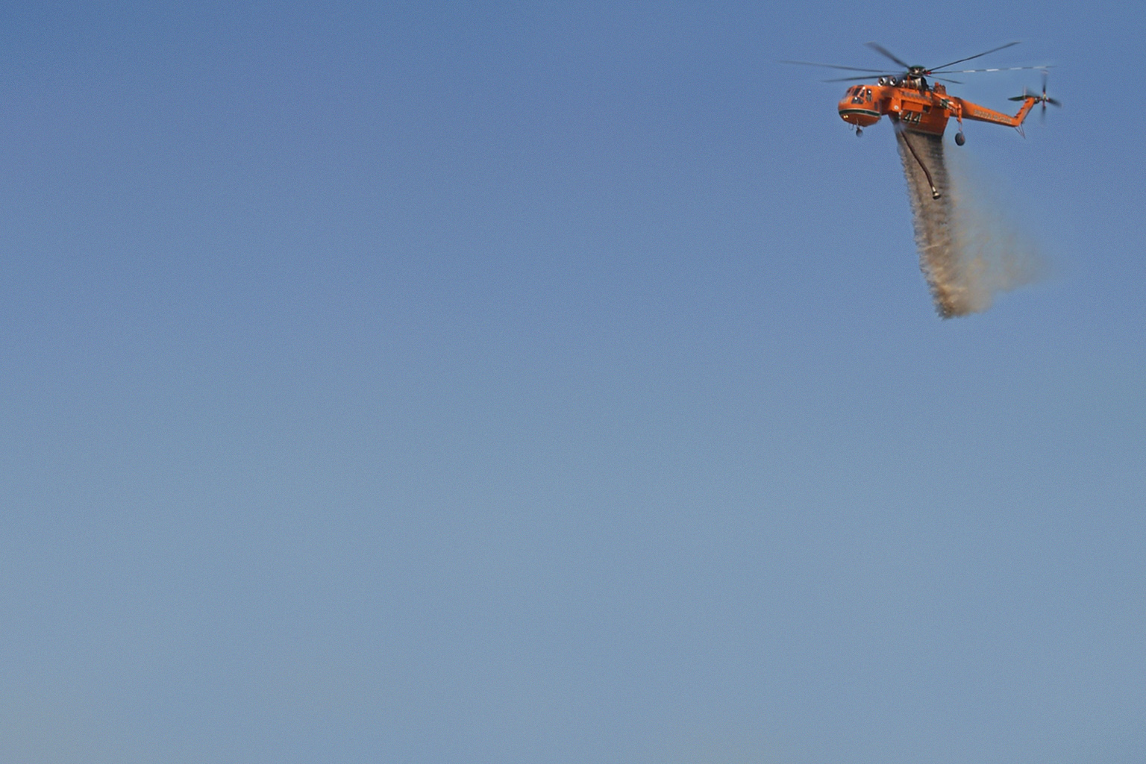
Overview
USGS Organization
  Overview of USGS wildland fire science activities
  Pre-fire
  During fire
  Post-fire
  Examples
  Future of USGS Fire Science

Slide 3
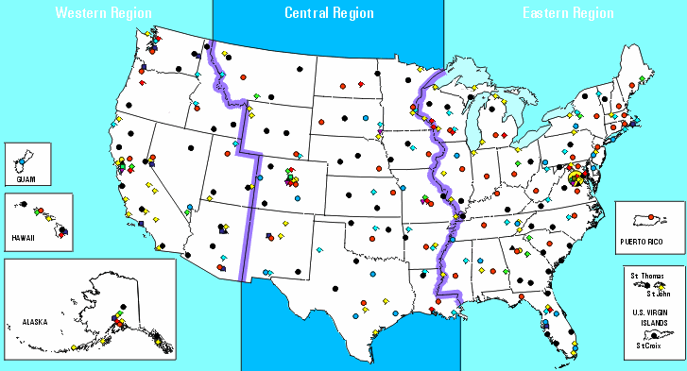
USGS Director’s office and leadership
The USGS is a science organization that provides information on the health of our ecosystems and environment, natural hazards that threaten public safety and values, natural resources, the impacts of climate and land-use change, and science delivery systems that help us provide timely, relevant, and useable information.
Natural Hazards
Ecosystems
Climate and land-use change
Energy, minerals, and environmental health
Regional USGS Offices
Water
Core Science Systems

Slide 4
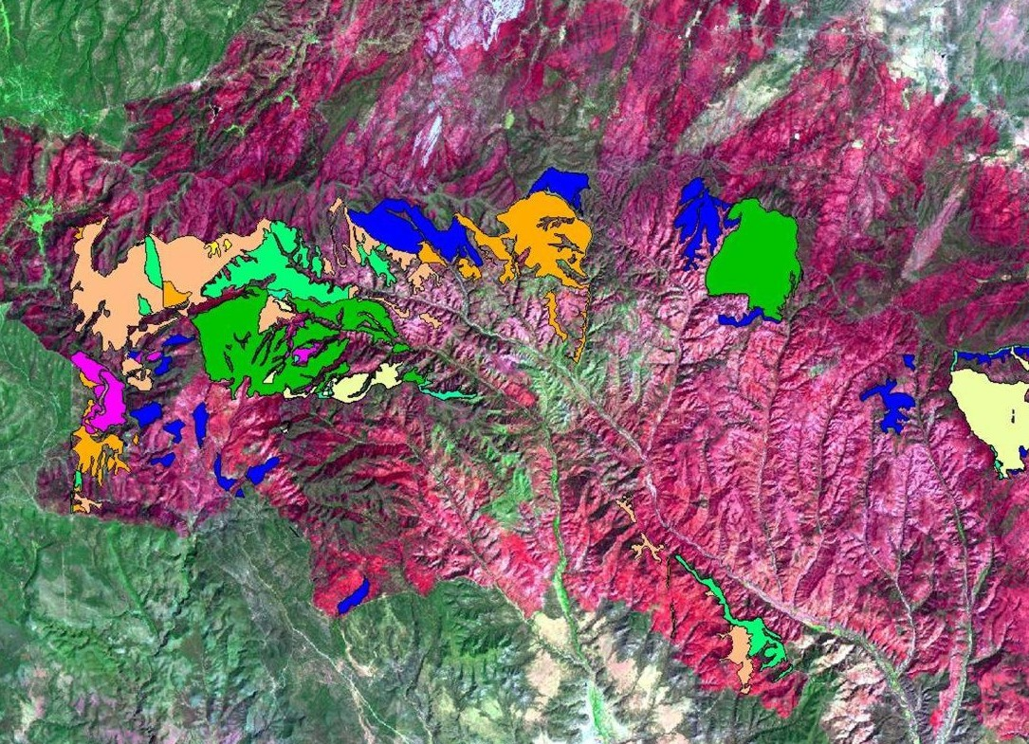
Rodeo Chediski Fire – Arizona, 2003
Wildfires and Fort Apache prescribed burns and thinning 1993-2001

Slide 5
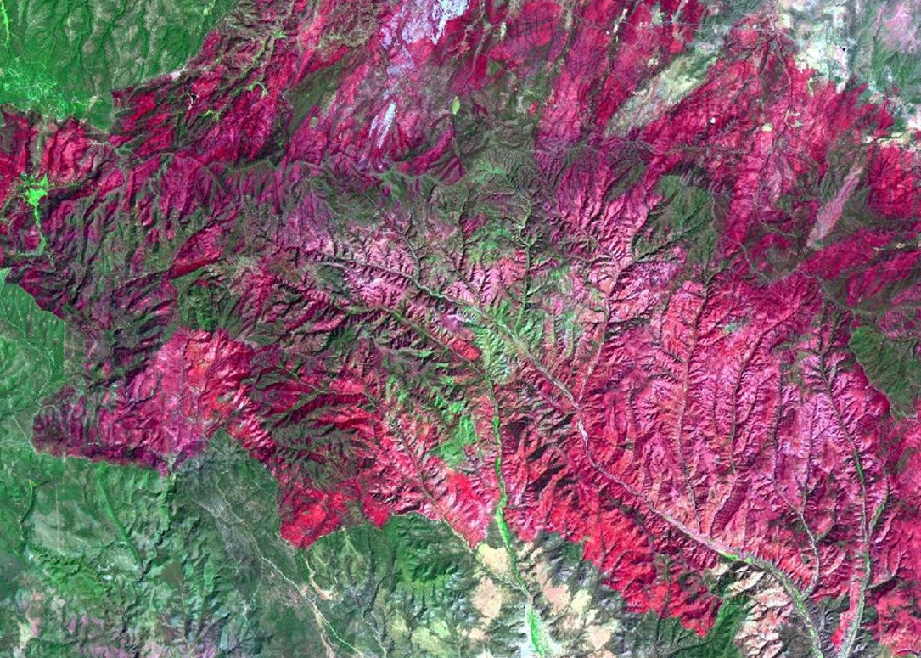
Rodeo Chediski Fire – Arizona, 2002

Slide 6
USGS Fire Science Activities
ECOSYSTEMS
Fire and invasive species
Wildlife and fish habitat effects
Effects of fuel treatments on landscapes
Montane/Alpine fire regimes and climate change

Slide 7
USGS Fire Science Activities
CLIMATE AND LAND-USE CHANGE
National surface and canopy fuels map
Remote sensing based fire histories
Wildland fire, carbon cycles, and climate change
Geospatial support for wildfire incidents and planning

Slide 8
USGS Fire Science Activities
Land slide and debris flow monitoring and forecasting
Water quality and supply monitoring and forecasting
Toxicity of fire suppression chemicals

Slide 9
Examples

Slide 10
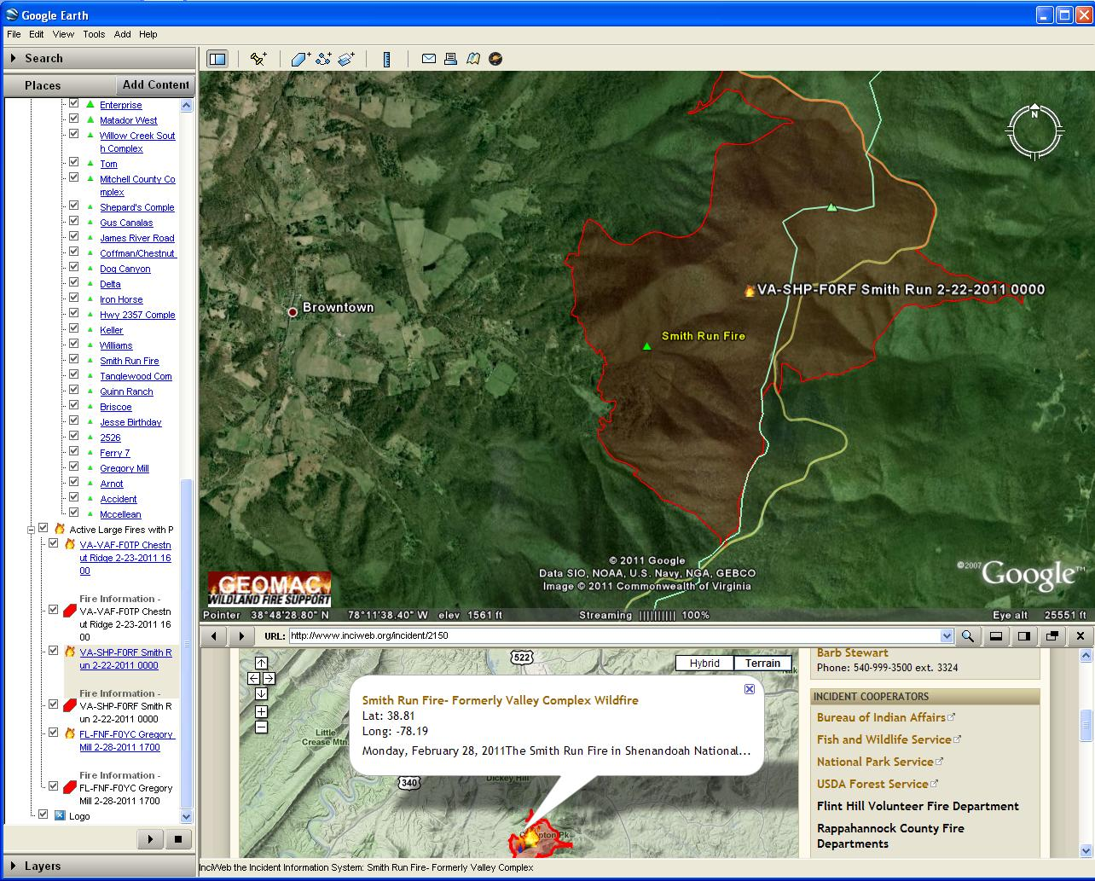
GeoMAC KML’s used by InciWeb
RMGSC Wildland Fire Support
Notes:
GeoMAC KML Service in Google Earth links to InciWeb (http://www.inciweb.org/), which shows the GeoMAC KML perimeter

Slide 11
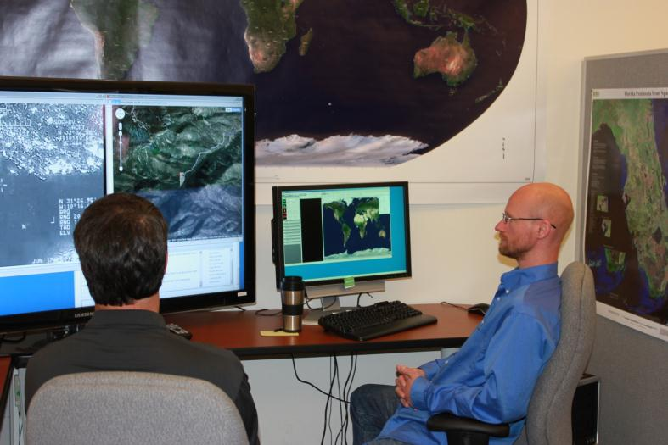
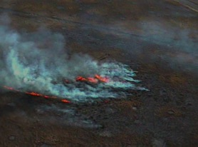
RMGSC Wildland Fire Support
Other Research Activities:
  Fire Perimeter collection using UAS in Arizona
  UAS program has demonstrated fire-related applicatins
  Fire Ecology Research
  Fire Effects on Land Carbon Sequestration
  Supported advanced sensor research of DoD assets for early detection of fire occurrence

Slide 12
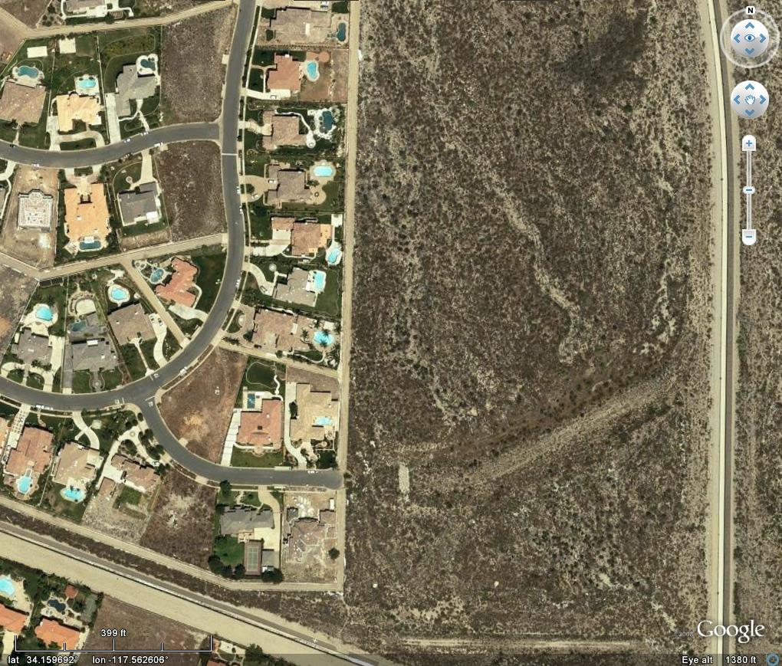
Science Application for Risk Reduction
Wildlands
WUI
Urban
Image: Google Earth
Notes:
12
12

Slide 13
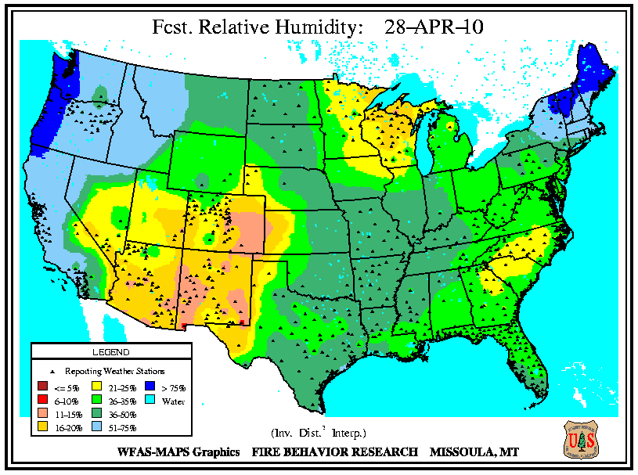
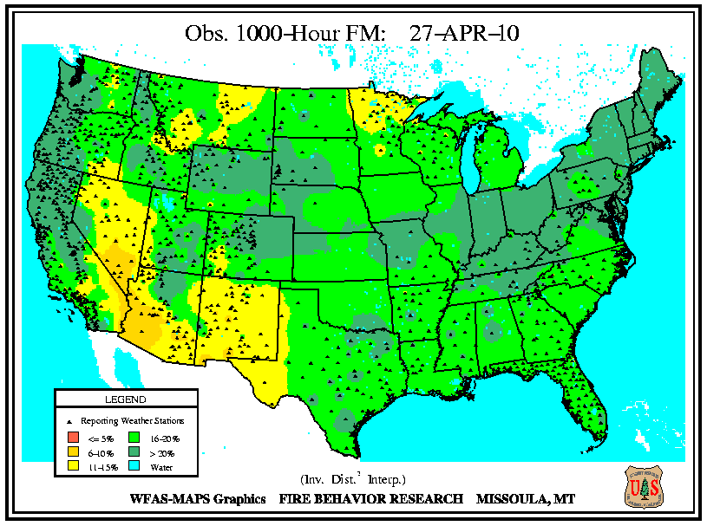
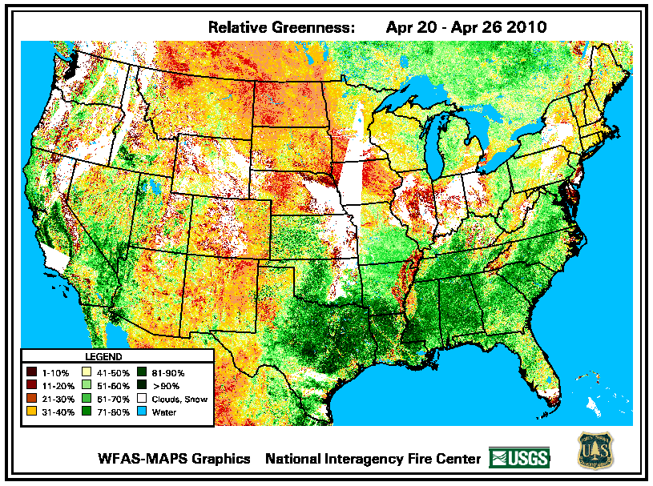
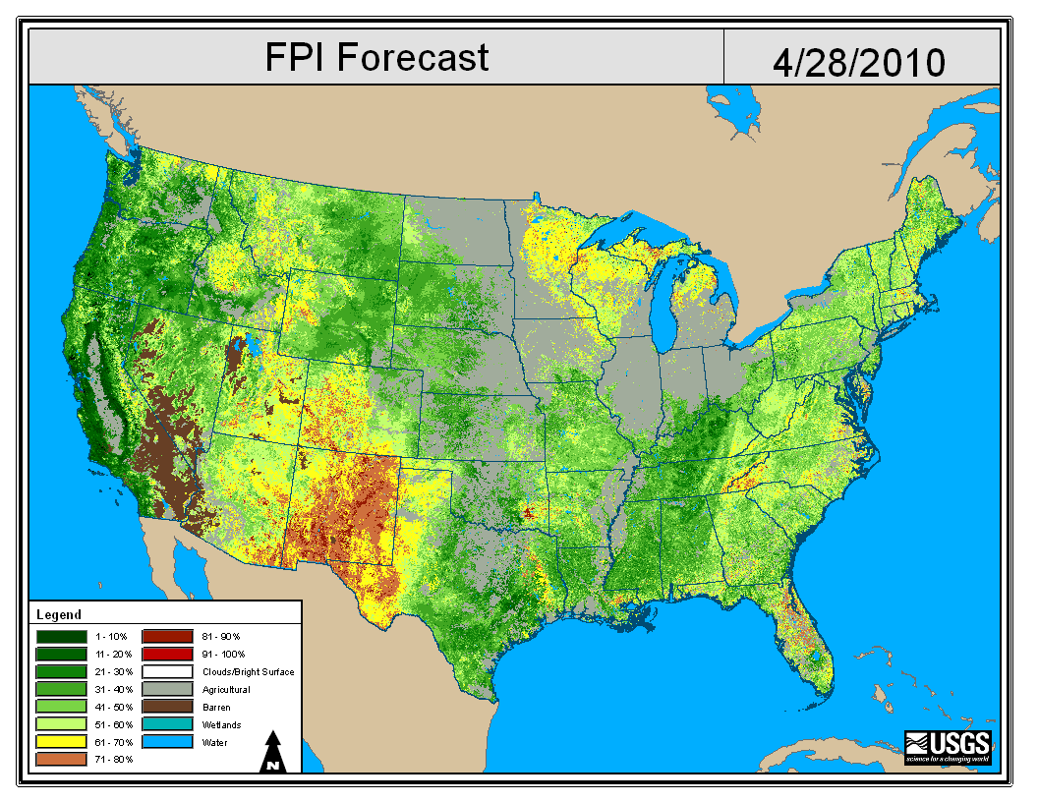


Wildland Fire Assessment System
NOAA Forecast Data
Fuel Moisture
Relative Greenness
National Maps of:
Probability that a fire will get large
Number of large fires (10⁶ km⁻² wk⁻¹)
Expected # fires (10⁵ km⁻² wk⁻¹)
Expected # extreme fires (10⁶ km⁻² wk⁻¹).

Slide 14
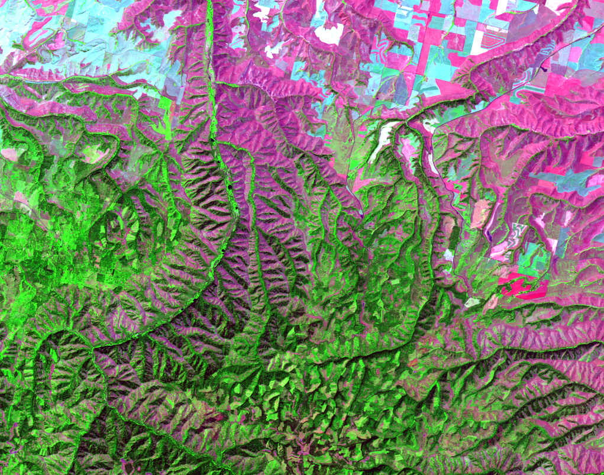
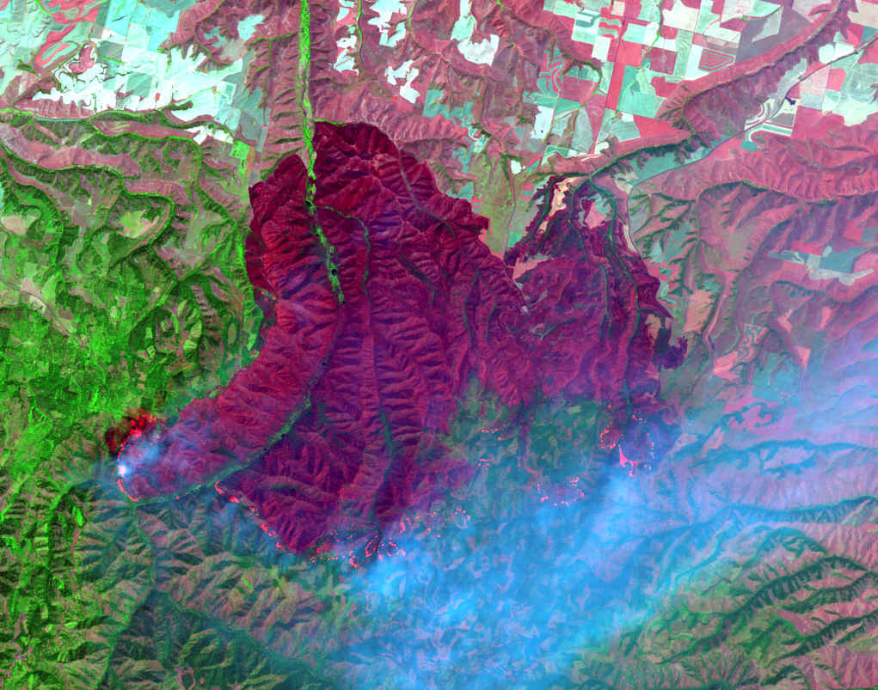
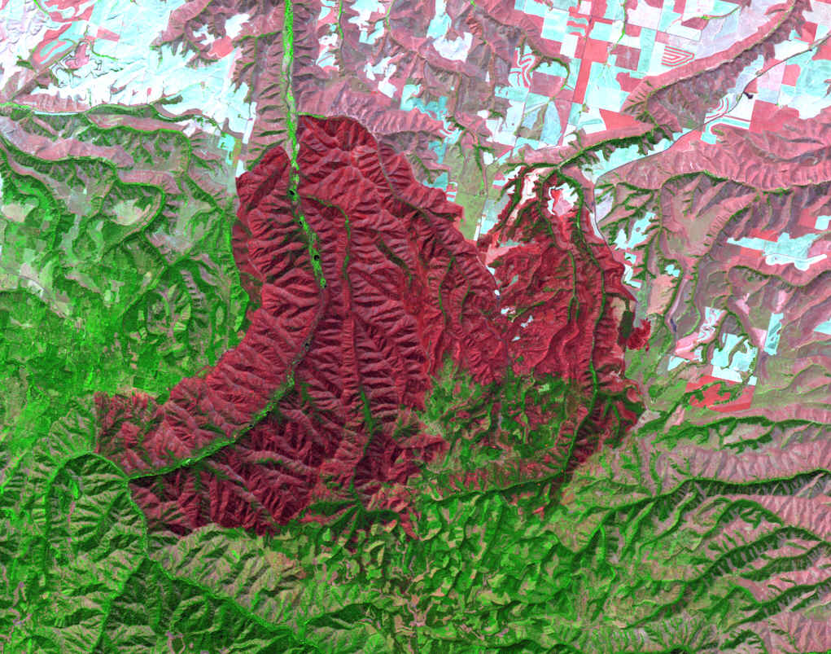
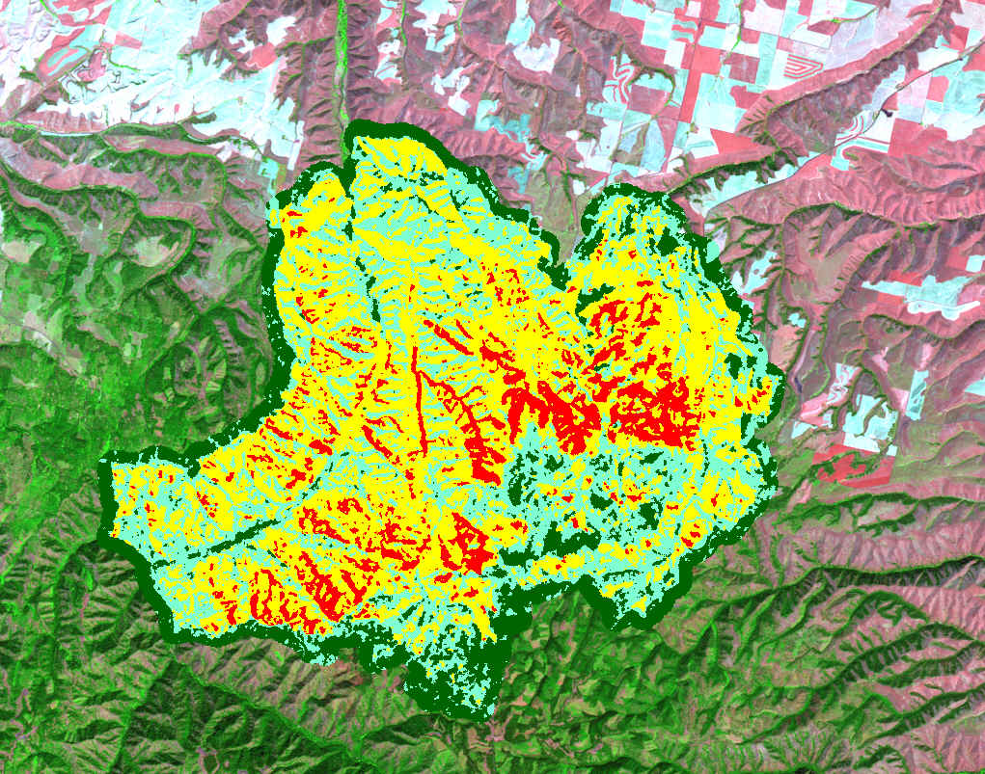
Burn Severity Assessment
Burned Area Reflectance Classification (BARC)
School Fire – Oregon, 2005
Prefire
Postfire
Postfire
Notes:
Animated Slide! School Fire (Umatilla NF, 2005): Prefire scene: July 24, 2005; Active fire scene: August 9, 2005; Postfire scene: August 25, 2005

Slide 15
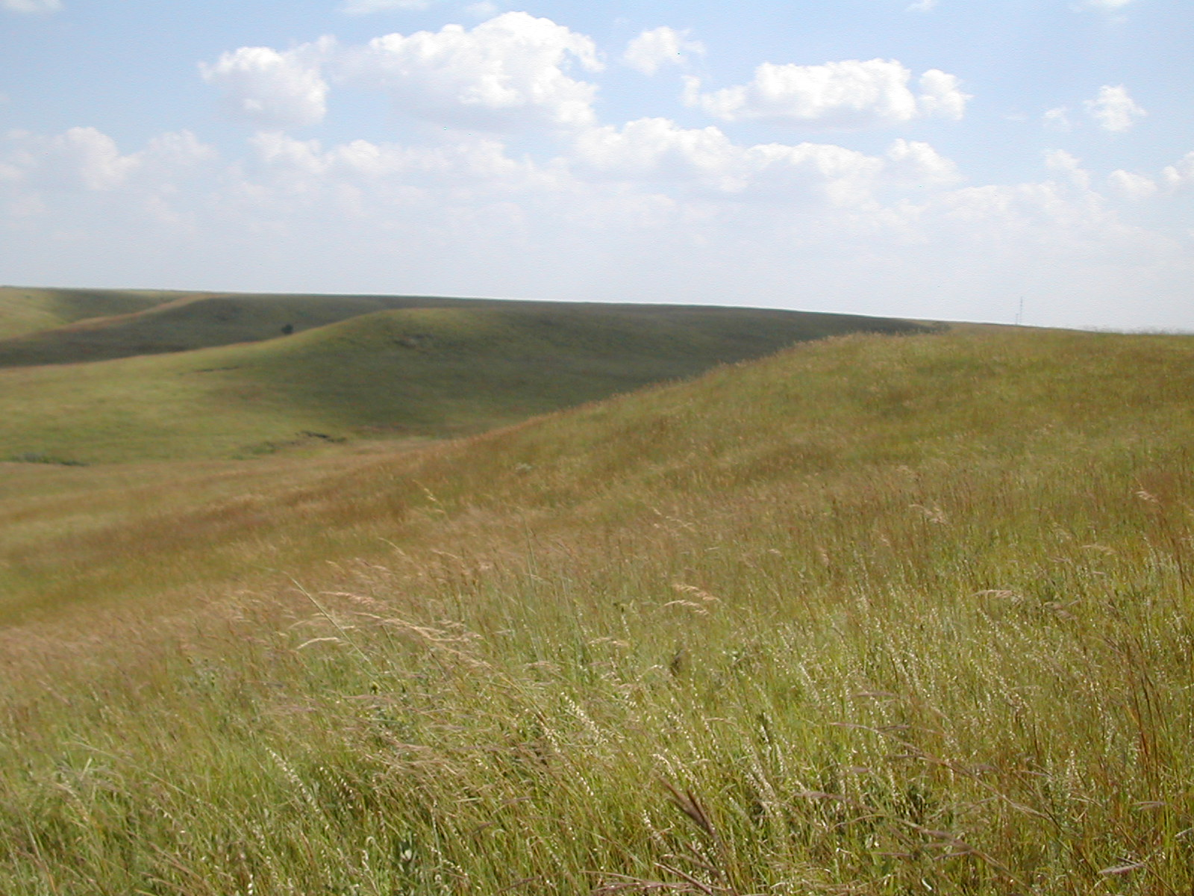
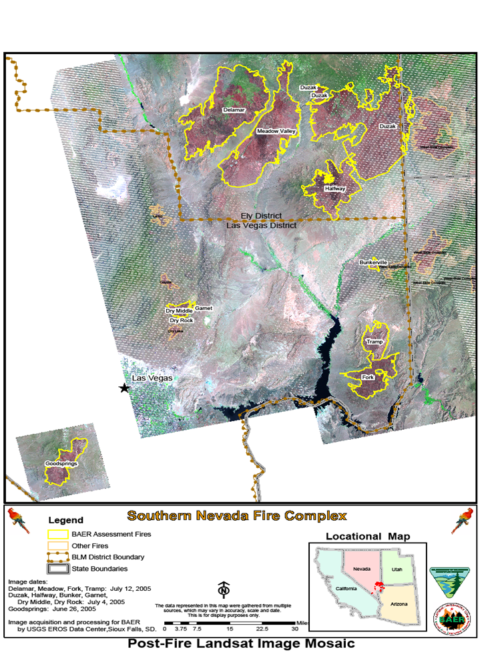

Slide 16
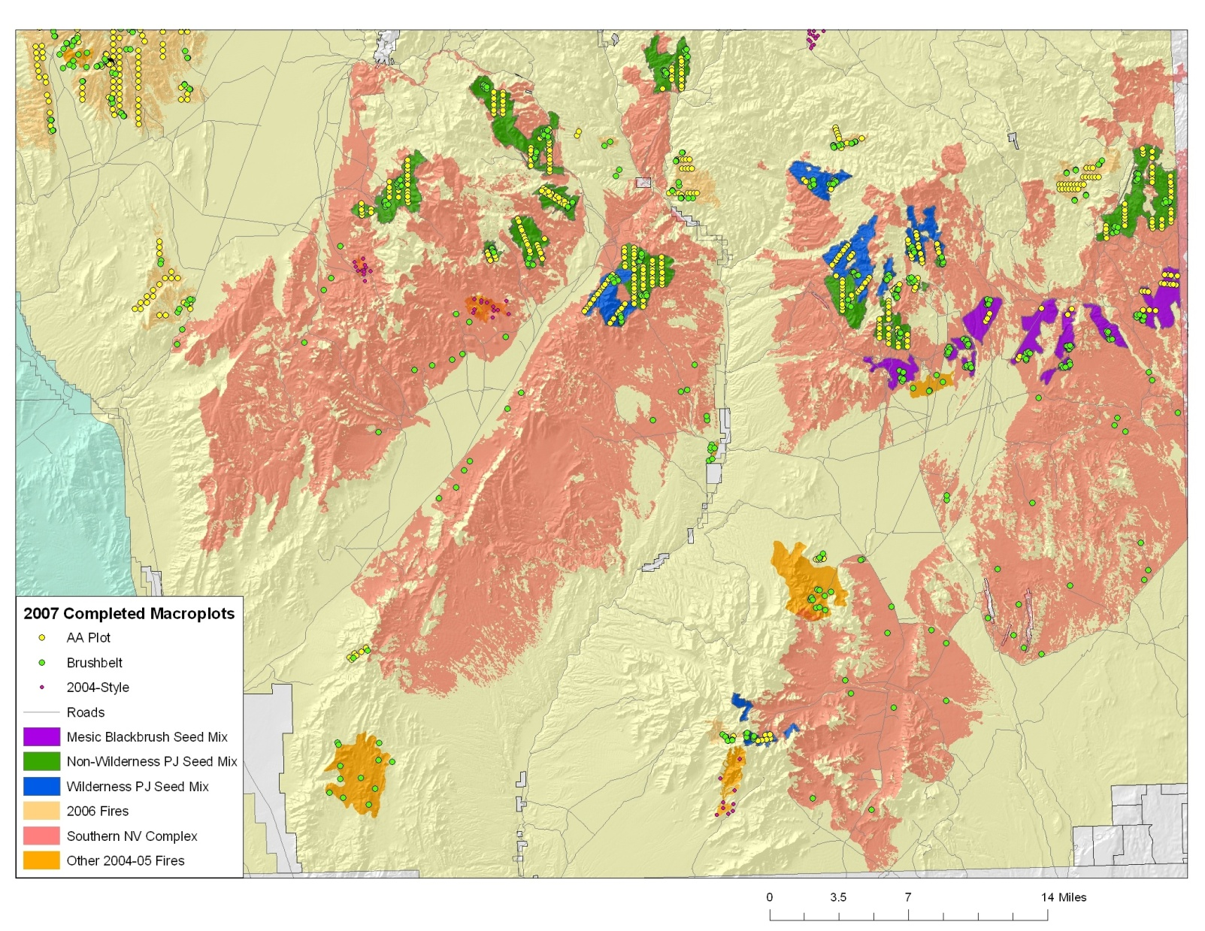
Rangeland Restoration
Ely, Nevada
Notes:
16

Slide 17
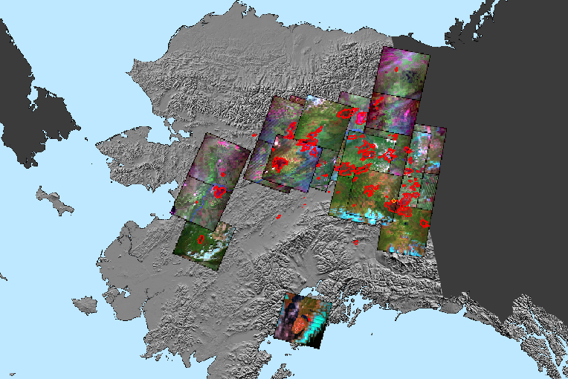
Burn Severity Assessment, Alaska

Slide 18
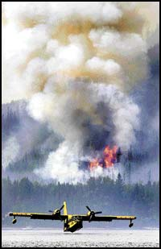

Monitoring Trends in Burn Severity
  Duration: FY2006 - FY2011.
  Fires over 1,000 acres in West, 500 in East.
  Severity mapped using time series of Landsat imagery and Differenced Normalized Burn Ratio.
  Evaluate ‘historical fires’:
  1984 – 2003
  Annual evaluations (current fires) 2004 – 2010
  MTBS has mapped over 10,000 fires
Roberts Fire
Glacier National Park
August 2003

Slide 19
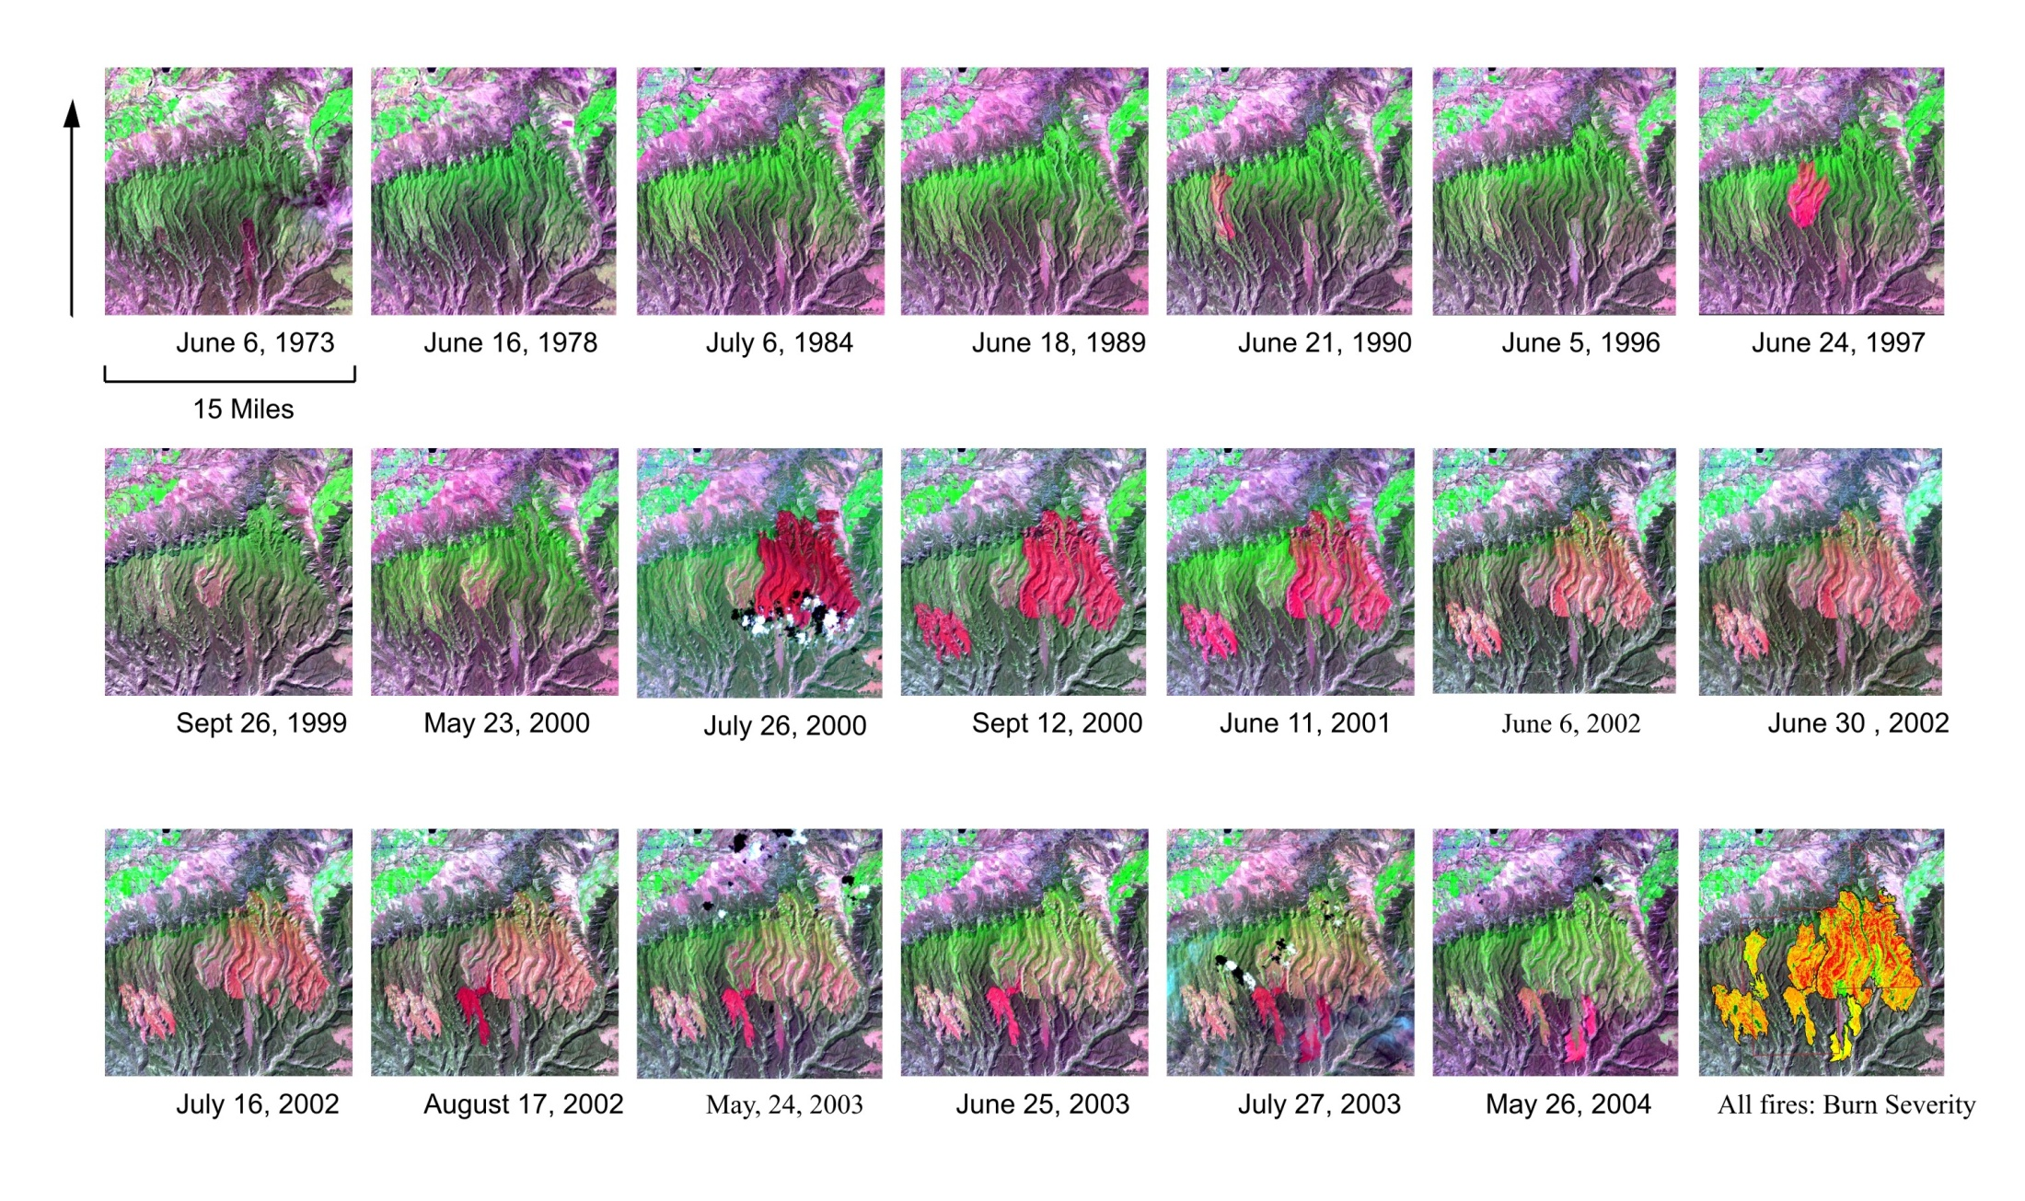
Monitoring Trends in Burn Severity

Slide 20
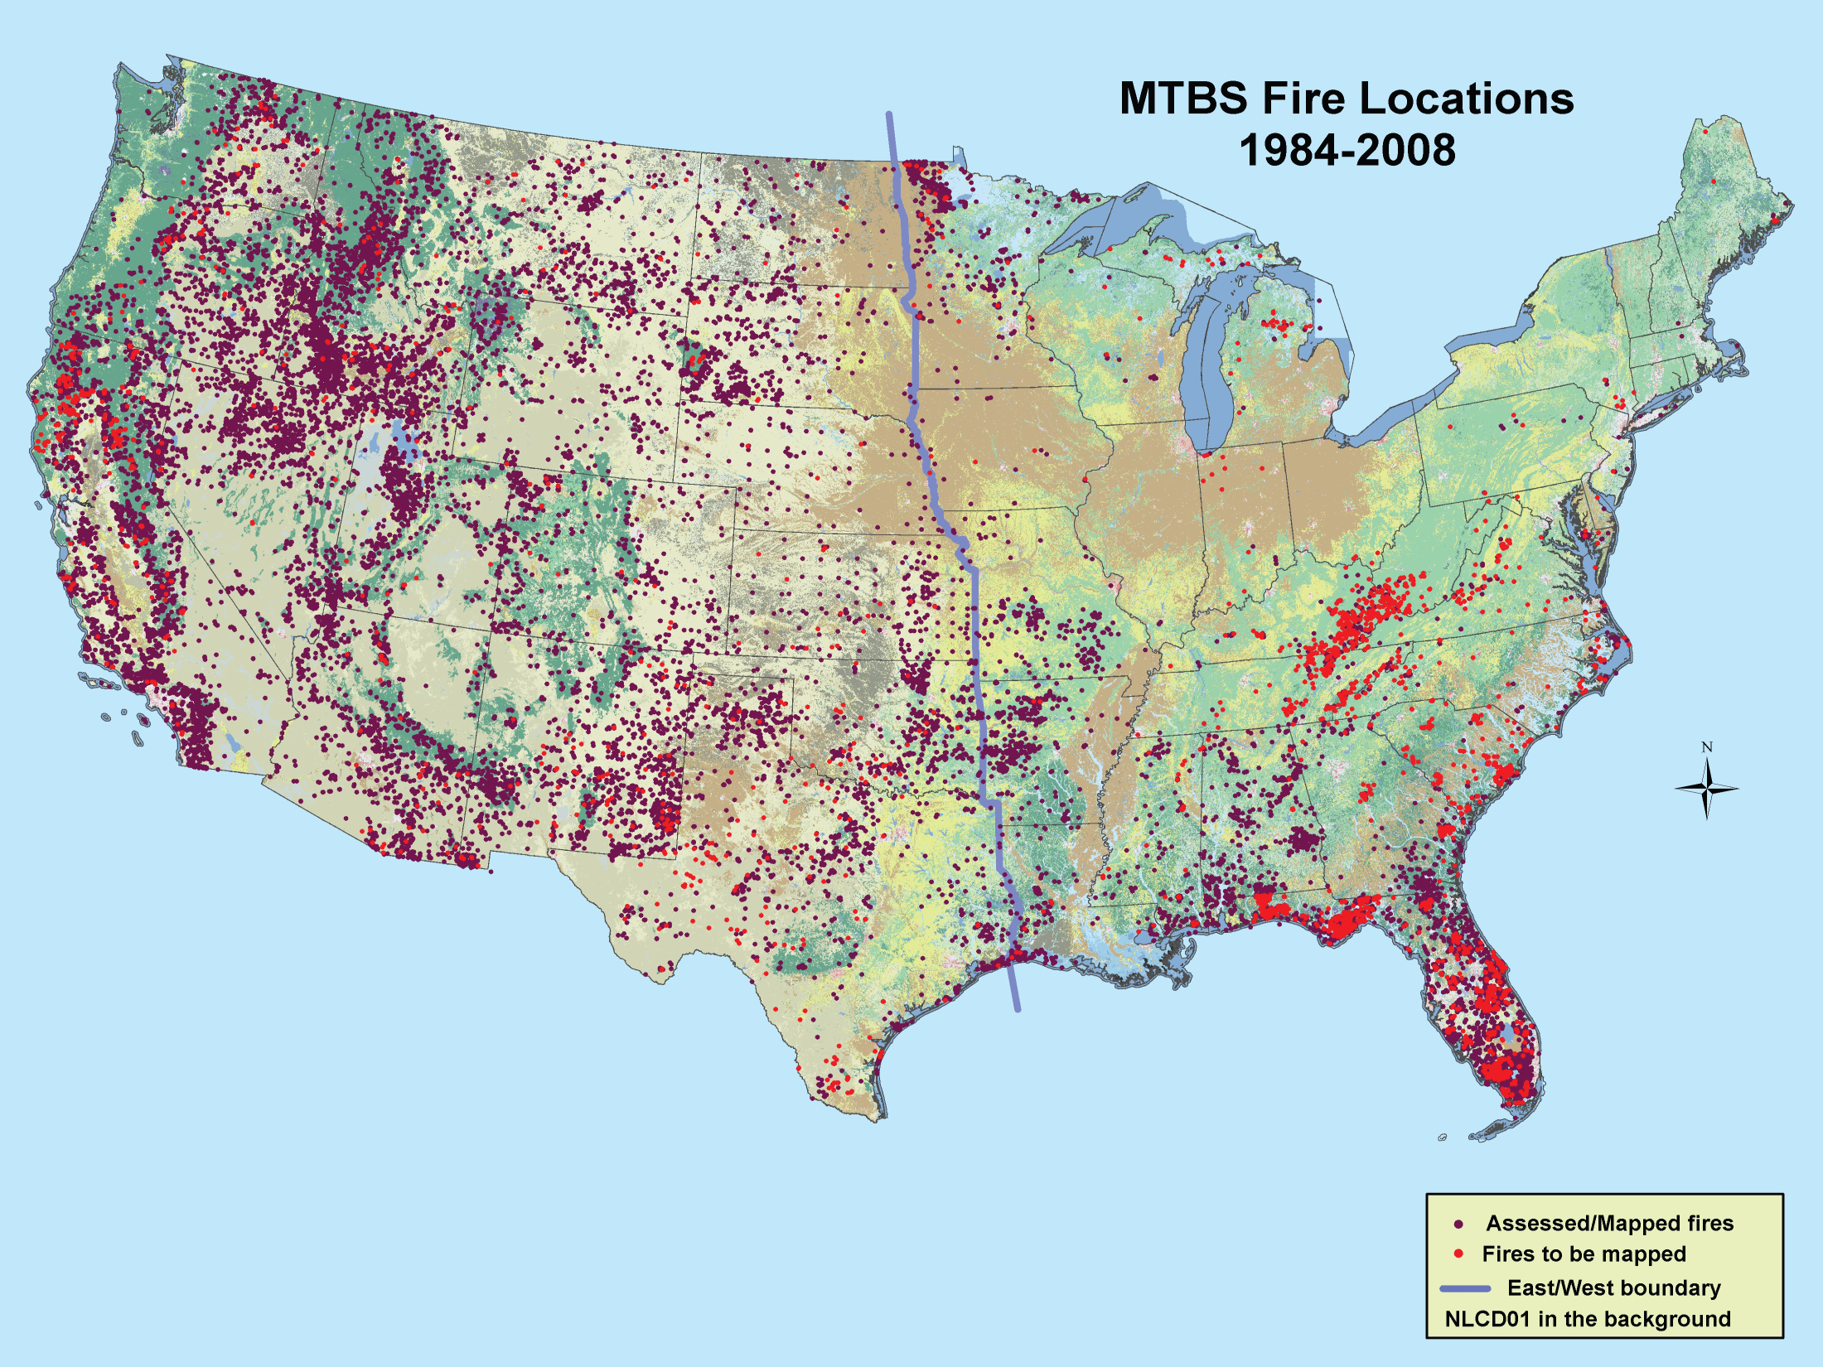
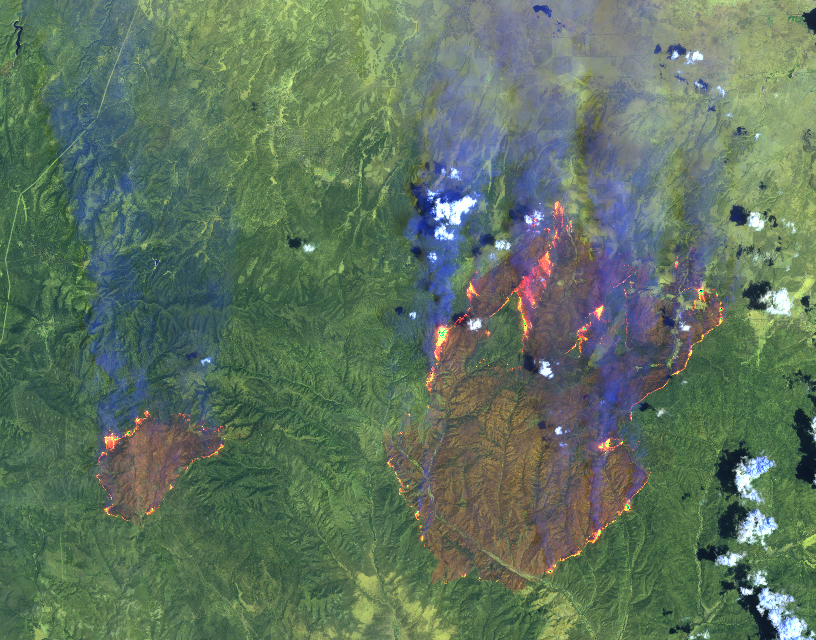

Slide 21
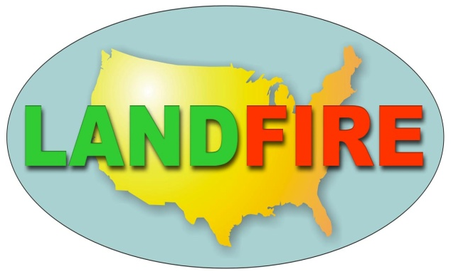

LANDFIRE in One Page
Objectives
A national assessment of vegetation, fuel and ecosystem conditions
Consistent, comprehensive, repeatable
Intended applications
Fire hazard assessment
Fuel management
National strategic planning
Incident support
Other land management applications
24 primary data products
30m nominal resolution nationwide
  Vegetation (potential and existing vegetation, structure, and succession classes) – ES / NVCS
  Fuel (surface and canopy)
  Fire regime condition class (reference conditions, departure from reference conditions)

Slide 22
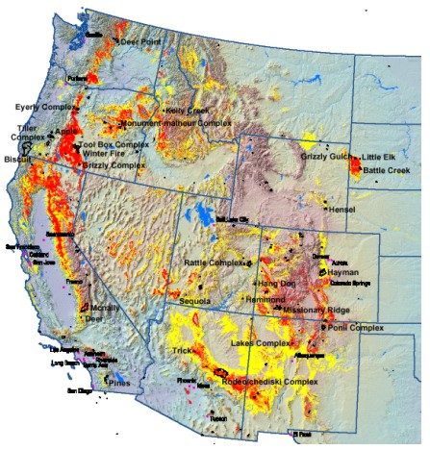
LF History
‘Coarse scale’ National FRCC map, 1999
2002 large fire locations by fire regime condition classes 2 and 3 for Fire Regime Group I.
(0-35 yr., low severity)
Notes:
Limitations of the Coarse Scale.

Slide 23
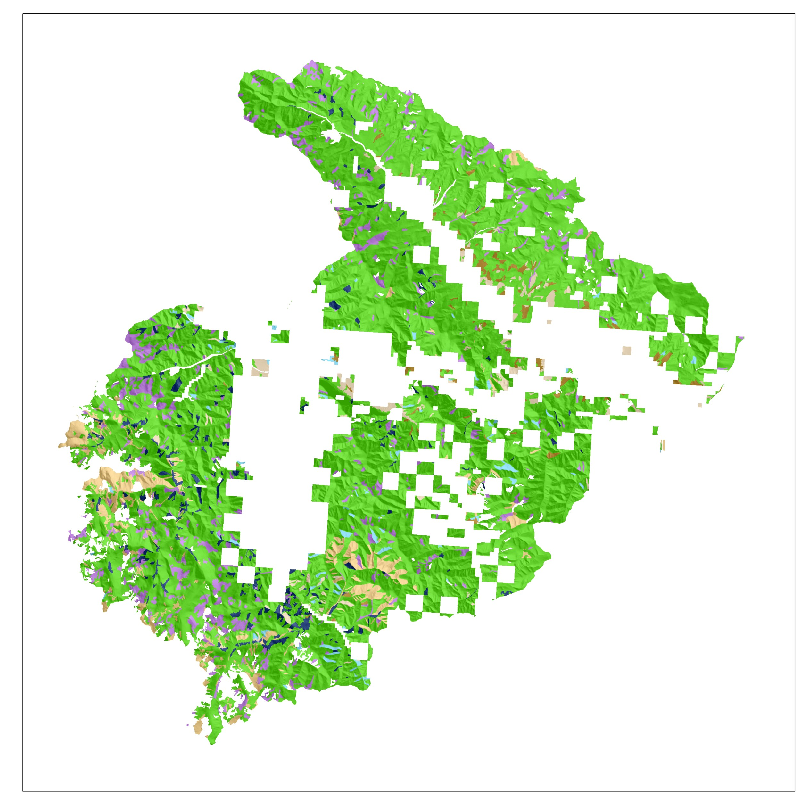
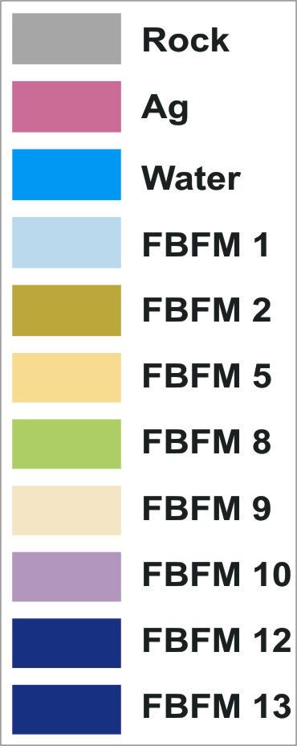
9-Mile Ranger District, Lolo National Forest, Ca. 2000
Notes:
This was the state of the art in federal fuel mapping prior to LANDFIRE

Slide 24
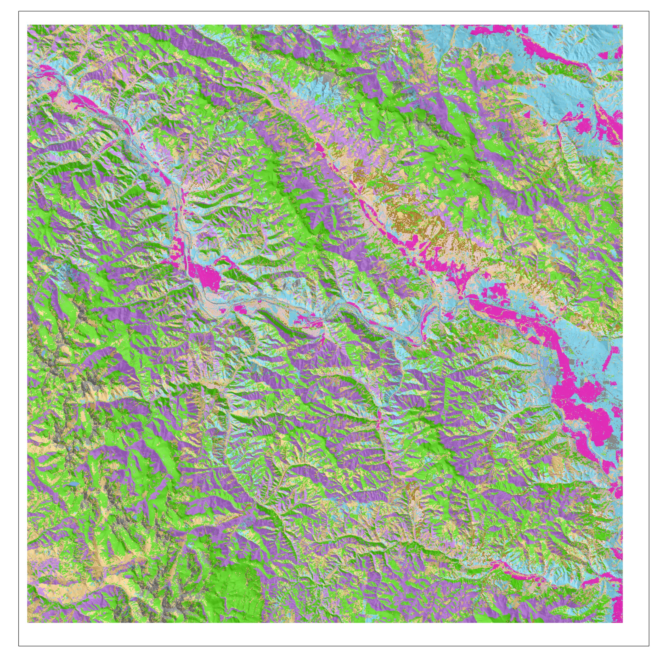
9-Mile Ranger District, Lolo National Forest, Ca. 2000
Notes:
Comprehensive data allow for management across administrative boundaries.

Slide 25
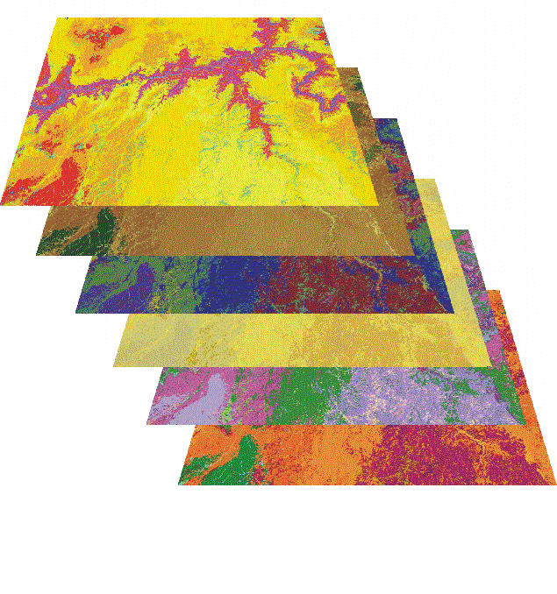
The Integrated
LANDFIRE Vegetation Database
Potential Vegetation
Environmental Site Potential
Biophysical Setting
Existing Vegetation
Existing Vegetation
Vegetation Cover
Vegetation Height
Wildland fuels
Surface Fire Behavior Fuel models
Canopy fuel

Slide 26
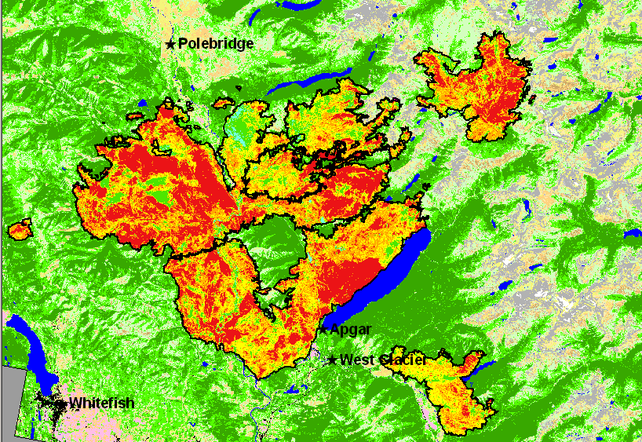
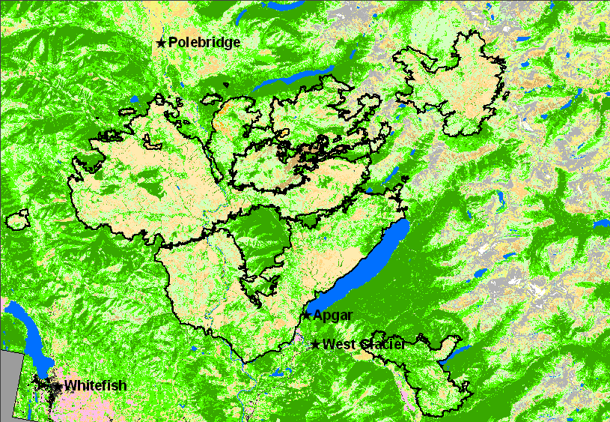
LANDFIRE Data Products
LANDFIRE Data Products are based on
Field-Referenced Data and Landsat 7 imagery
  Surface Fuel Models
  Fire Effects Models
  Historical Fire Regimes
  Fire Regime Condition Class
  Canopy Fuels
  Vegetation Composition
  Vegetation Structure
  Potential Vegetation
Glacier National Park wildfires
Updated LANDFIRE Vegetation

Slide 27
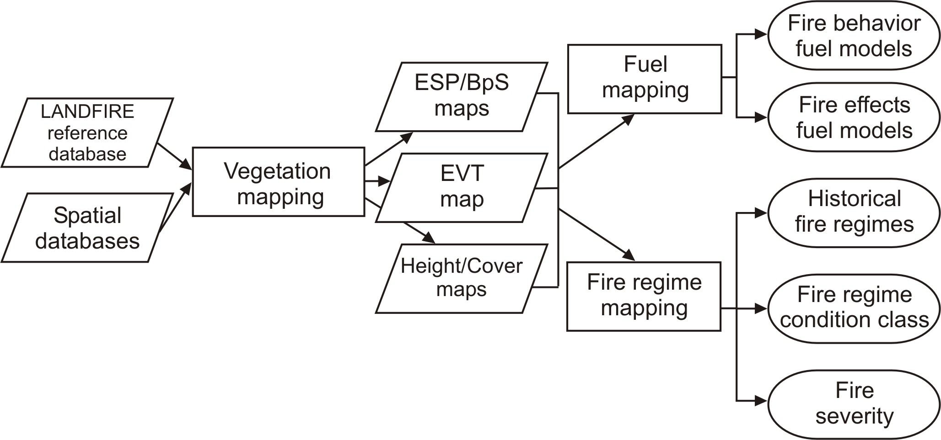
The LANDFIRE process
Production
Dependencies

Slide 28
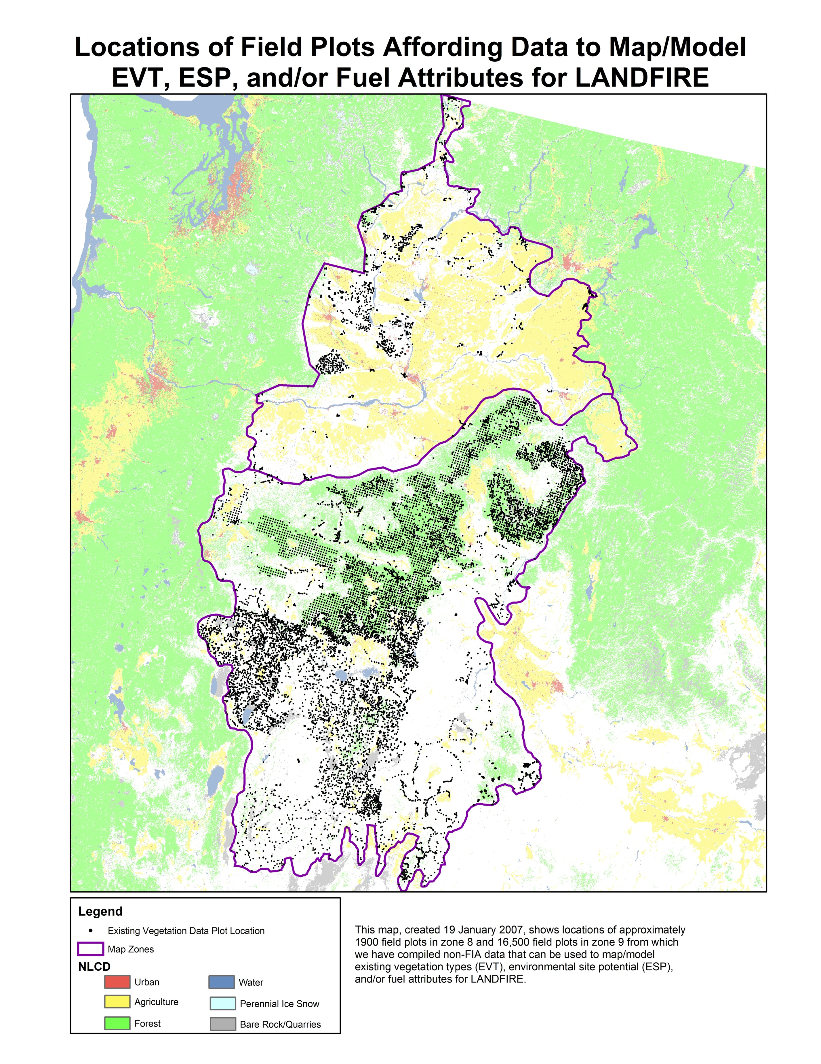
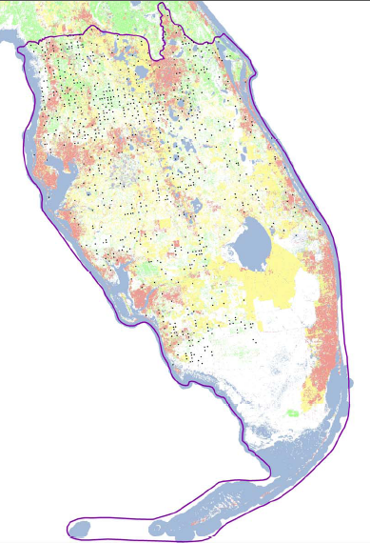
Field-referenced data

Slide 29
LANDFIRE Reference Database
1m+ records for all 50 states
5%
5%
Other
BLM
7%
State
USFS
(FIA, NRIS)
43%
13%
Multi-partner
USGS
(GAP)
27%

Slide 30
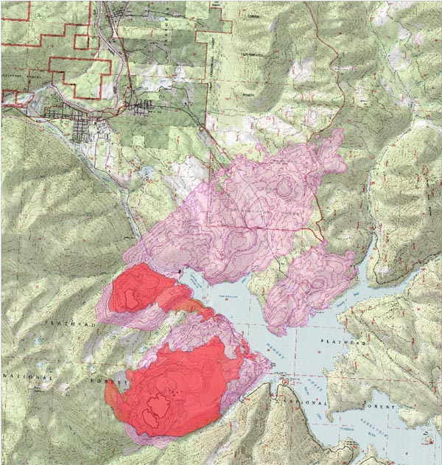
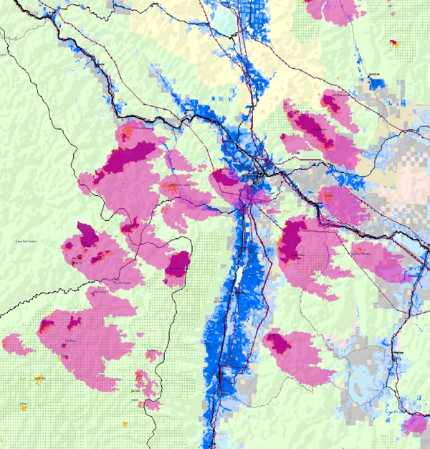
Fire Management Applications
Bottom-up and Top Down
Beta-Doris Fire
2003
Western Montana 2003
Current Perimeter
Hydro-electric Plant
Missoula
Expected Fire Growth
Current Perimeter
Populated Areas
Landscape scale
Regional scale
Inputs to models that simulate real time fire behavior
Notes:
(2/8/05) This is a better description of what the maps are but maps need legends describing colors and a brief description is needed on fire spread, growth, direction, arrows with names pointing to significant features on the maps. These may be better explained on separate slides. It is difficult to tell what is what and the progression of simulations.
Done
LANDFIRE provides inputs to models that simulate real time fire behavior.
The left figure shows the Beta-Doris Fire 25 miles south of Glacier Park, Montana. FARSITE simulations using LANDFIRE fuels data showed that the fire was likely to spot across Hungry Horse reservoir. It takes time to move resources to this area with narrow mountain roads and long distances. The Incident Command team was able to preposition resources across the reservoir, who were able to successfully initially attack the fire when it did indeed spot to the north, perhaps saving the town of Martin City, Montana.
The right figure shows a regional application where every day the current MODIS fire perimeters were used to parameterize FARSITE along with the LANDFIRE fuels layers. FARSITE was run under a variety of weather scenarios to provide the Multi-Agency Command with rapid response information about where fire complexes were likely to spread over 100 million acre area in Northern Idaho and Western Montana. Fire Management, EMS, and County Sheriffs used this information to preposition resources and to issue pre-evacuation notices. Bonneville Power Company provided data on the location of power lines and fire managers were able to pre-treat under several lines preventing a disruption of power service to the entire Northwestern United States.

Slide 31
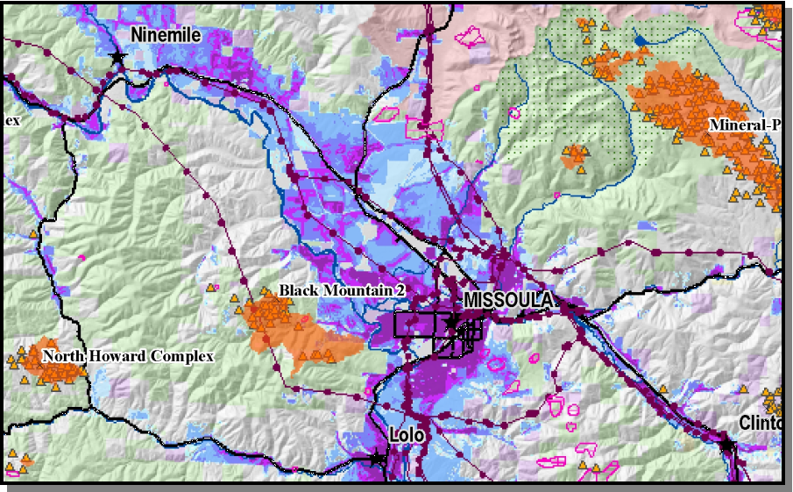
Maps of Values at Risk Maps
Ownerships
Major
Roads
Wilderness
Power lines
Population Density
Notes:
Here is a close-up of the same area with current fire perimeters and MODIS fire pixels in orange. On these maps land ownerships, roads, power-lines, and population centers are shown.
“Values at Risk Maps” such as this one were used in conjunction with FARSITE simulations as shown in the previous slide to help optimize allocation of suppression resources & emergency management personnel.
FARSITE simulations helped to:
provide Information to support local law enforcement in their decisions, i.e., potential areas to be evacuated/potential road closures;
Informing the power company of potential risk to the power grid;
inform managers of the likelihood of fires moving in and out of various management units, e.g., the wilderness areas;
or other ownerships.
This allowed managers to identify more efficient ways to support individual fires, e.g., decisions to preferentially secure fire lines in places where the fire was likely to spread vs. not concentrate resources in areas that were unlikely to pose a threat.

Slide 32
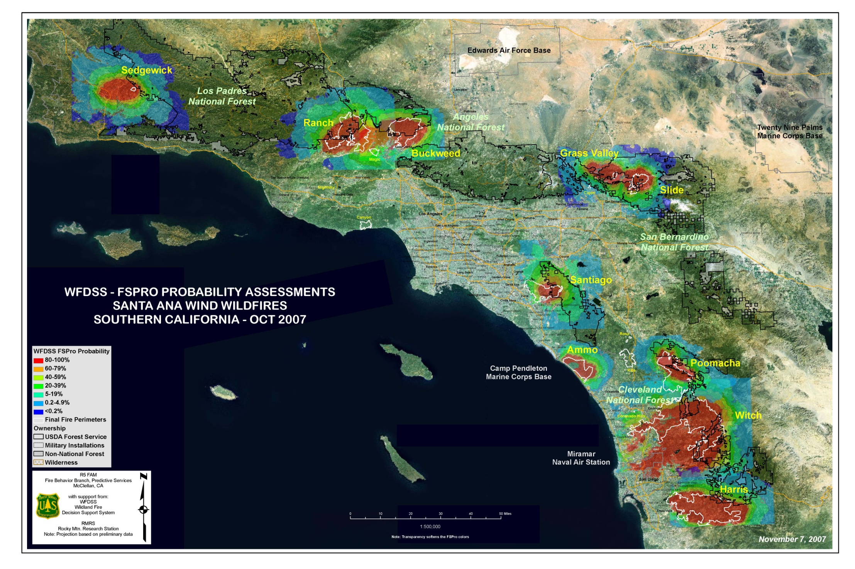
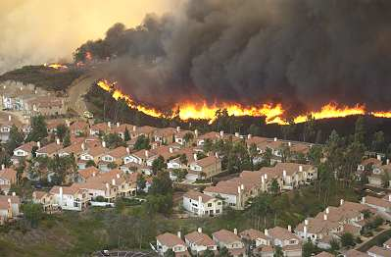

Slide 33
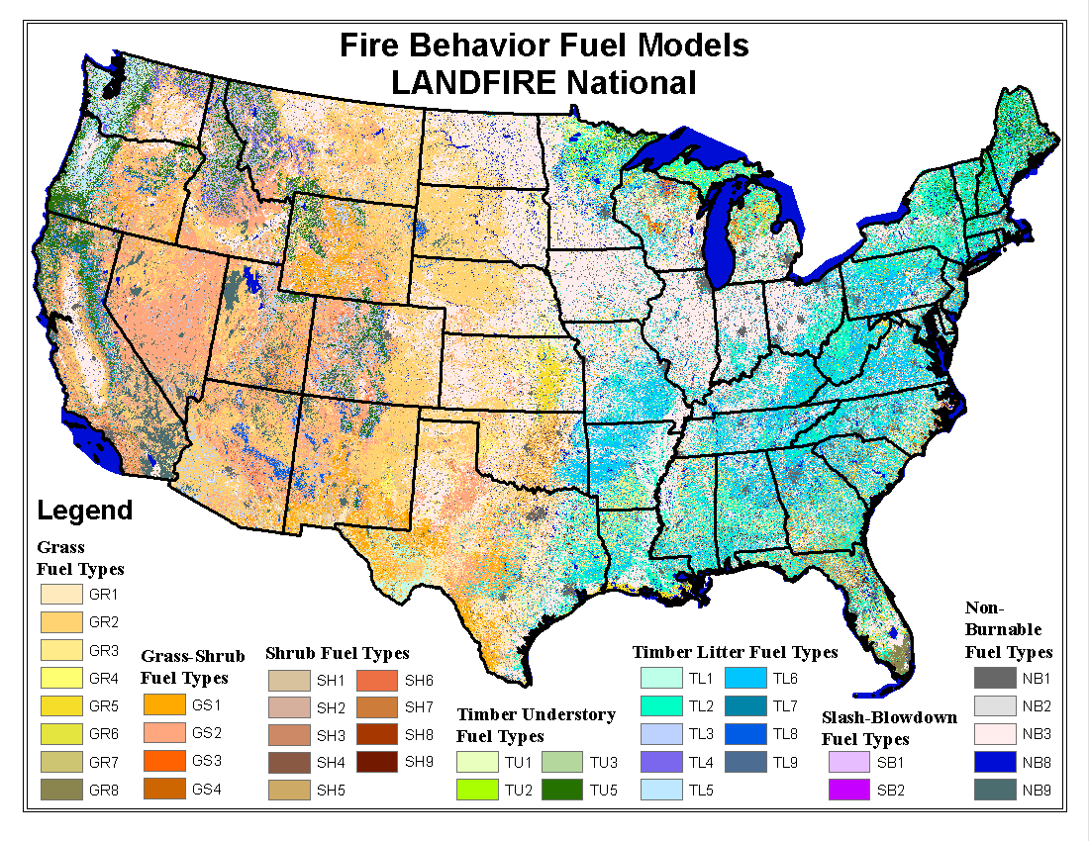
http://www.landfire.gov

Slide 34
Strengths of USGS fire science
Integrated, interdisciplinary science and applications.
Independent, impartial monitoring capabilities.
Remote sensing capabilities coupled with field-based ecology and landscape modeling expertise.
Well established partnerships with federal, state, and private organizations.
Geospatial technical support to national-to-local tactical and strategic wildland fire management.

Slide 35
Opportunities for USGS Fire Science to support DOI Office of Wildland Fire Coordination
Continue to enhance coordination between USGS and OWFC with focus on:
Wildfire response
Characterizing fuels around communities at risk
Supporting landscape restoration
Increase direct USGS collaboration with OWFC.
Increase USGS Fire Science to support key assets at OWFC such as LANDFIRE, MTBS, GeoMac, JFSP, and risk assessment.
Maintain active role in Joint Fire Science Program.

